Slide 1
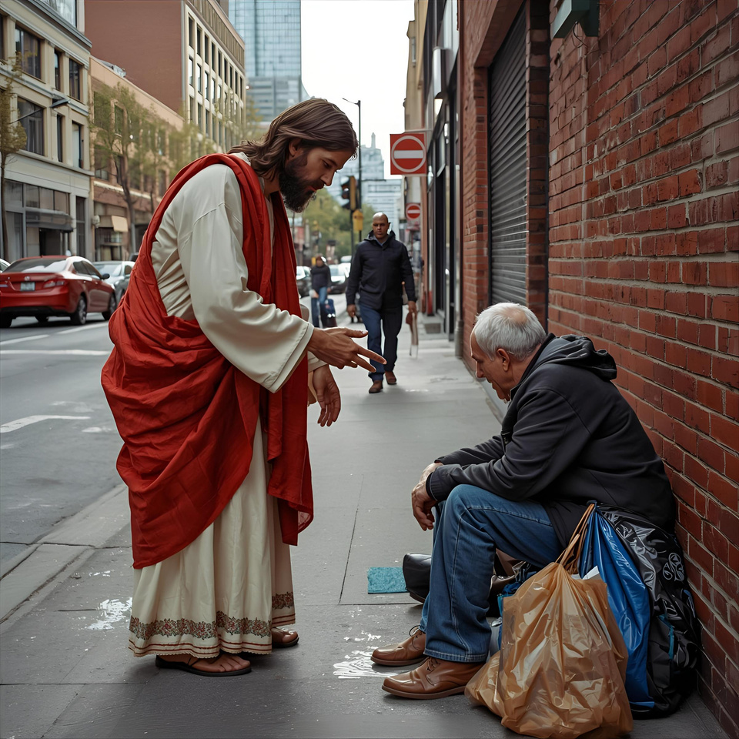



GIVING
TUESDAY
December 1

